Slide 1
Cost as a dependent variable
Mark Bounthavong, PharmD, PhD
26 April 2023

Slide 2
Poll # 1
What types of models have you used for cost data as an outcome (dependent) variable?
Ordinary Least Squares (Linear Regression) Model
Log-Transformed (Log-OLS) Model
Generalized Linear Model
Two-part model
I have never modeled cost as an outcome before

Slide 3
Past presentations on cost as a dependent variable
Paul Barnett has done a two-part series on Cost As A Dependent Variable
Part 1 (link)
Part 2 (link)
HERC Cyberseminars on Econometric Methods (Past Sessions)

Slide 4
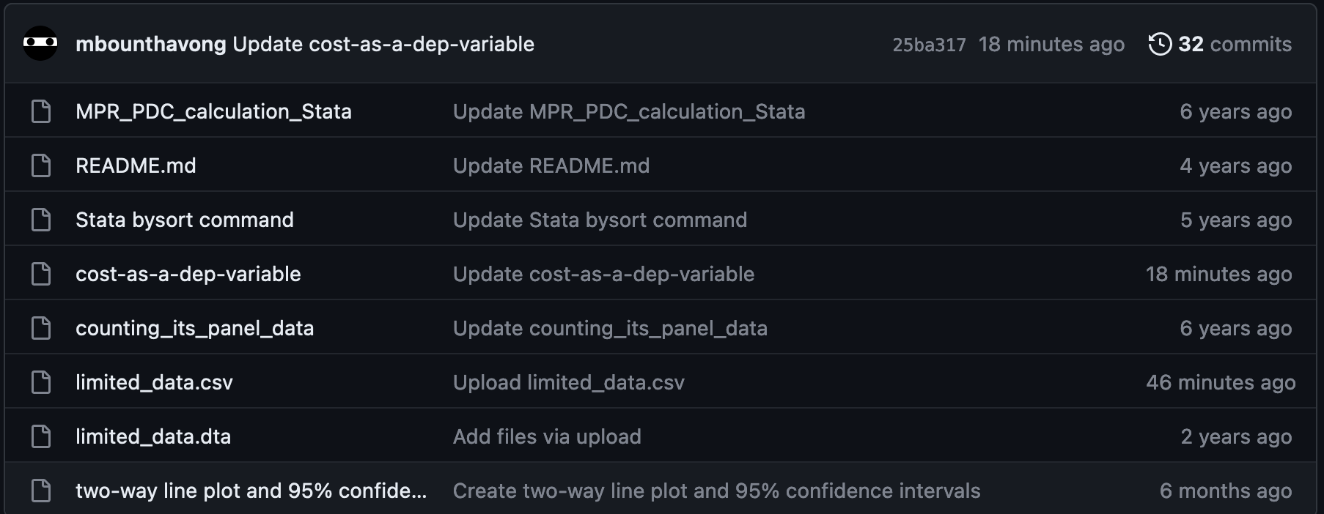
Files for this presentation are located on GitHub
This presentation includes files to perform the analysis with cost as a dependent variable
All files are located on GitHub

Slide 5
Background
Cost distribution is usually skewed with thin right tails
Cost distribution also have a substantial density of zero values
Ordinary Least Squares (OLS) methods are insufficient
However, other methods take into account the skewness and large point mass at zero
We will explore alternative methods to OLS when modeling costs data as a dependent variable

Slide 6
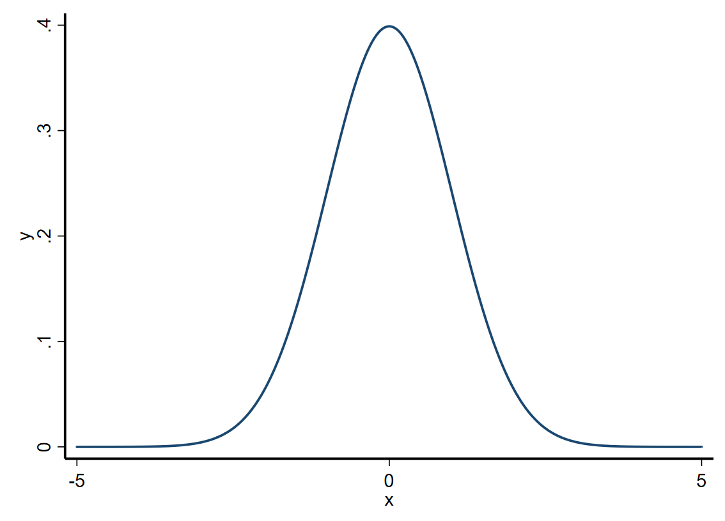
Characteristics of data
Skewness is a measure of how asymmetric a distribution is around its mean (skewness = 0)
Kurtosis is a measure of how heavy the tail ends of the distributions are (kurtosis = 3)
Mean = 0
SD = 1
**** Plot a normal distribution with x = 0 and sd = 1
graph twoway function y=normalden(x,0,1),
range(-5 5) lw(medthick) legend(off) xscale(lw(medthick)) yscale(lw(medthick)) graphregion(color(white)) bgcolor(white) ylabel(, nogrid)

Slide 7
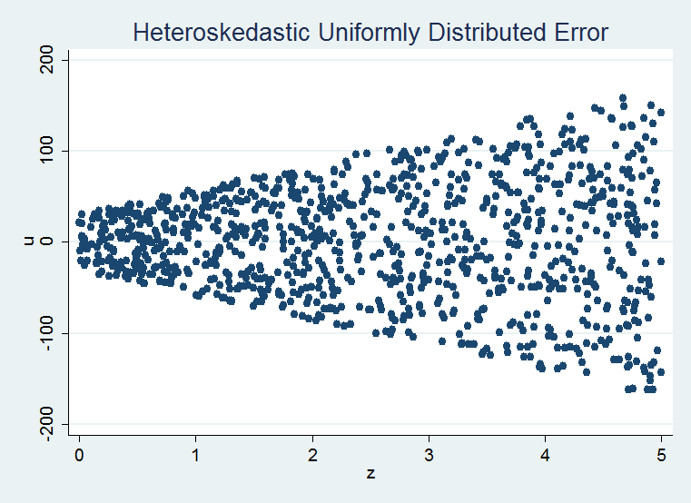
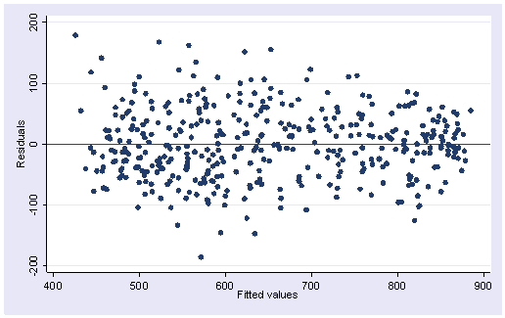
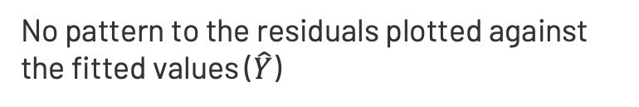
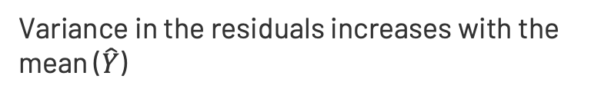
Checking Homoscedasticity of Residuals
No pattern to the residuals plotted against the fitted values ($\hat{Y}$)
Variance in the residuals increases with the mean ($\hat{Y}$)
Source (link), (link)

Slide 8
Motivating Example: Total expenditures, MEPS 2017 (1)
Data can be downloaded from MEPS or GitHub
We will use Stata SE version 15 for this exercise
Several ways to download / load example data
GitHub link for Stata code

Slide 9
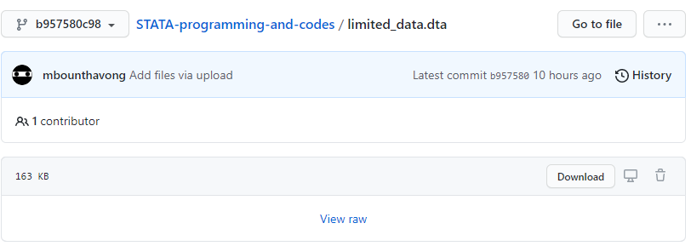
Motivating Example: Total expenditures, MEPS 2017 (2)
Method 1: Download data from GitHub and Load into Stata
For WINDOWS users
Download data onto your computer
GitHub link for Stata code

Slide 10


Motivating Example: Total expenditures, MEPS 2017 (3)
Save data and modify the code to the Windows path location
Windows file path uses the file explorer
(Make sure to include quotations)
GitHub link for Stata code

Slide 11
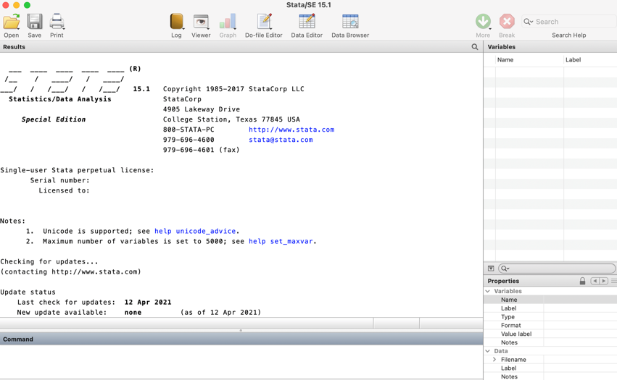
Motivating Example: Total expenditures, MEPS 2017 (4)
For MAC users
For Mac OS, drag and drop folder into the command line to get the path
GitHub link for Stata code

Slide 12
Motivating Example: Total expenditures, MEPS 2017 (5)
Method 2: Import CSV data from GitHub directly into Stata
For WINDOWS/MAC users
***** FOR WINDOWS or MAC:
clear all
import delimited "https://raw.githubusercontent.com/mbounthavong/STATA-programming-and-codes/master/limited_data.csv"
GitHub link for Stata code

Slide 13
Motivating Example: Total expenditures, MEPS 2017 (6)
Goal: To evaluate the average total healthcare expenditures among household respondents diagnosed with high blood pressure
Methods: Use different regression models; Control for baseline demographics (e.g., age, gender, race, ethnicity, poverty status, marital status, and census region)

Slide 14
Motivating Example: Total expenditures, MEPS 2017 (7)
Notations:
Y = Cost
Xi = Independent variables (X1, X2, …, Xn)
βi = Coefficients
Analytic Plan:
Models (OLS, Log-OLS, Log-OLS with smearing, GLM, and two-part models)
Goodness of Fit (GOF) tests
Compare mean healthcare expenditures

Slide 15
Goodness of Fit (GOF) tests
Pearson correlation: Correlation between raw scale cost predictions and residuals costs
Pregibon’s Link test: Run the same outcome model with XB and XB^2 as covariates. If NS, then the regression equation is properly specified and there are no additional independent variables that are significant except by chance
Hosmer-Lemeshow test:
Plot residuals across deciles of XB
Joint test to examine whether the mean residuals are zero

Slide 16
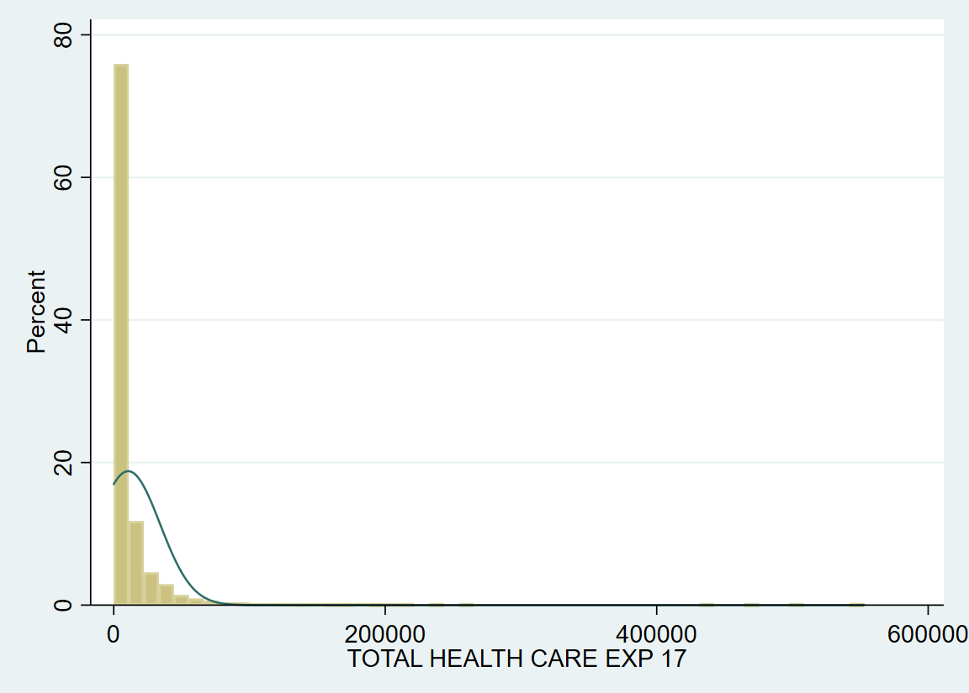
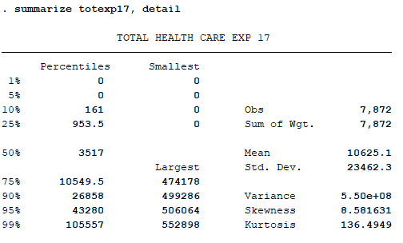
Data description: Total expenditures, MEPS 2017
The average total expenditures is $10,625 (SD, $23,463)
Low = $0 & High = $552,898
Skewness = 8.6
Kurtosis = 136

Slide 17
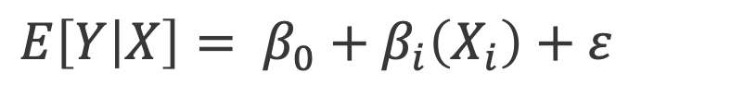
Model 1: OLS (Linear regression)
X = age, gender, race, ethnicity, poverty status, marital status, and census region
$$E\left[Y | X\right]= β_{0}+β_{i}\left(X_{i}\right)+ε$$
Linear models provide easy interpretation of the coefficients
However, because of the high skewness, any differences in the tails can have a great affect on the mean
Generates biased estimations due to the non-linearity of Y
Heteroscedasticity (variance increases with mean) generates inefficient standard errors

Slide 18
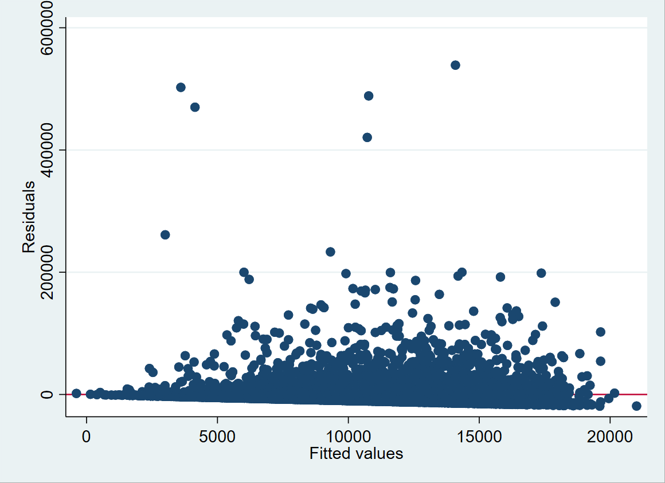
Model 1: OLS (Linear regression)
**** MODEL 1: OLS
reg totexp17 age17x sex racev2x hispanx marry17x povcat17 region17
predict yhat /* get the fitted values */
predict error, resid /* get the residuals */
graph twoway scatter error yhat /* plot the residuals to the fitted value */
≠

Slide 19
Poll # 2
How different is the OLS regression mean total expenditure compared to the raw mean total expenditure?
OLS regression mean is higher than the raw mean
OLS regression mean is lower than the raw mean
Both means are exactly the same

Slide 20
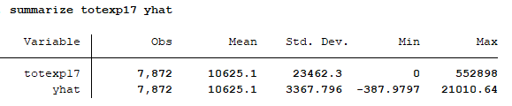
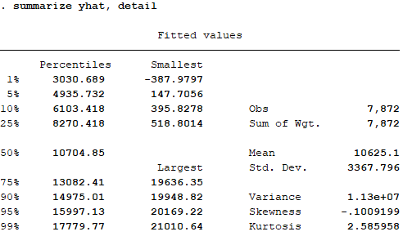
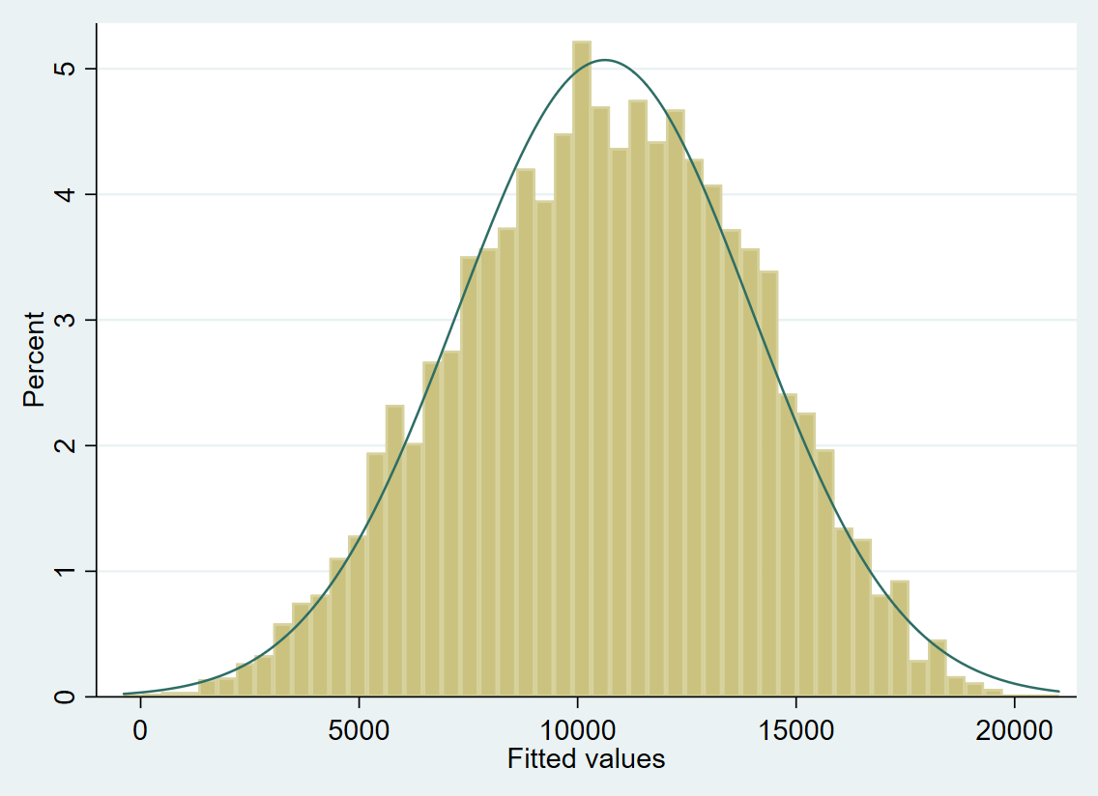
Model 1: OLS (Linear regression)
Mean costs are the same
But variances are different

Slide 21
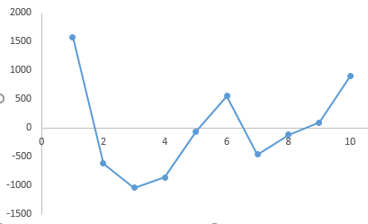
GOF tests: Model 1 (OLS)
Pearson correlation: No correlation between residuals and predicted costs (P = NS)
Pregibon’s Link test: Significant association between xb^2 and outcomes (P = 0.003)
Hosmer-Lemeshow test: No significant differences in the mean residuals (P = 0.549)

Slide 22
Comparison: OLS model versus Raw Costs
Features | Raw | OLS
Mean | 10,625.10 | 10,625.10
SD | 23,462.30 | 3,367.80
Min | 0.00 | -387.98
Max | 552,898.00 | 21,010.64
Median | 3,517.00 | 10,704.85

Slide 23
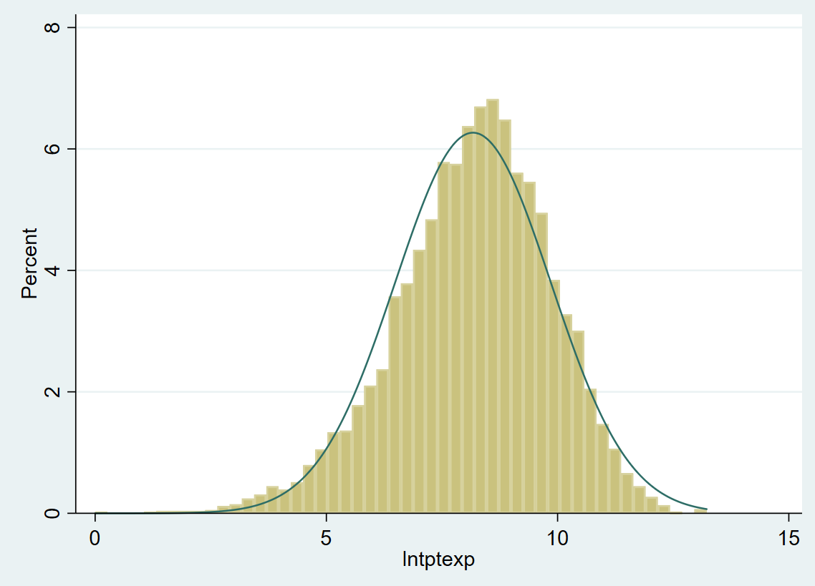
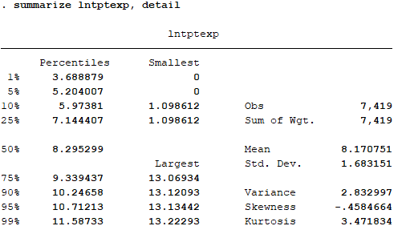
Model 2: Log transformation (Log-OLS)
Log transformation of the cost data can reduce skewness
Log dollars is not easy to interpret

Slide 24
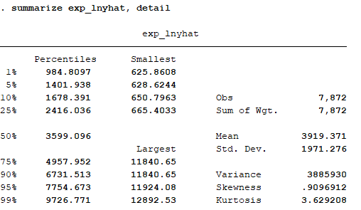
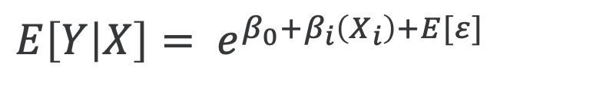
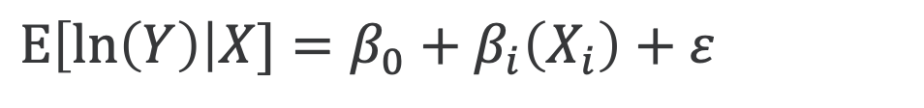
Model 2: Log transformation (Log-OLS)
$$E\left[\ln\left(Y\right)\right|X]=β_{0}+β_{i}\left(X_{i}\right)+ε$$
Expectation of the ln(y) is not the ln[E(y)]
$$E\left[Y | X\right]= e^{β_{0}+β_{i}\left(X_{i}\right)+E[ε]}$$
**** MODEL 2: Log-OLS
reg lntptexp age17x sex racev2x hispanx marry17x povcat17 region17
predict lh_yhat, xb
gen exp_lnyhat = exp(lh_yhat)
summarize exp_lnyhat, detail

Slide 25
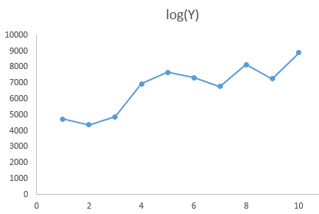
GOF tests: Model 2 (Log-OLS)
Pearson correlation: Significant correlation between residuals and predicted costs (P < 0.001)
Pregibon’s Link test: Significant association between xb^2 and outcomes (P = 0.028)
Hosmer-Lemeshow test: Significant differences in the mean residuals (P < 0.001)

Slide 26
Comparison: Log-OLS versus OLS & Raw Costs
Features | Raw | OLS | Log-OLS
Mean | 10,625.10 | 10,625.10 | 3,919.37
SD | 23,462.30 | 3,367.80 | 1,971.28
Min | 0.00 | -387.98 | 625.86
Max | 552,898.00 | 21,010.64 | 12,892.53
Median | 3,517.00 | 10,704.85 | 3,599.10

Slide 27
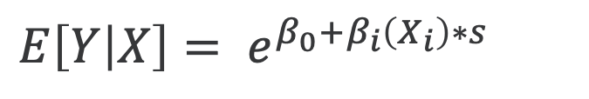
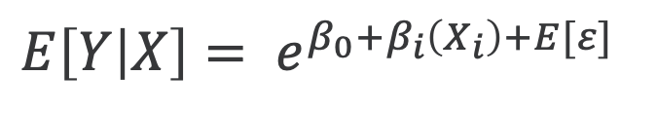
Model 3: Log transformation (Log-OLS) w/ smearing
$$E\left[Y | X\right]= e^{β_{0}+β_{i}\left(X_{i}\right)+E[ε]}$$
S is the smearing factor
$$E\left[Y | X\right]= e^{β_{0}+β_{i}\left(X_{i}\right)∗s}$$
Duan’s smearing estimator corrects for the retransformation issue with the log-OLS model
**** MODEL 3: Log-OLS w/smearing
reg lntptexp age17x sex racev2x hispanx marry17x povcat17
* Smearing estimator
gen smr = exp(lntptexp - lh_yhat)
summarize smr
gen smear = r(mean)
gen mu_lols = exp(lh_yhat) * smear
gen res_lols = totexp17 - mu_lols
summarize mu_lols, detail
Duan’s smearing estimator:
ln(Y) = XB + e
Y = exp(XB + e)
Y = exp(XB) * exp(e)
s = exp(e)
s = exp(ln(Y) – XB)

Slide 28
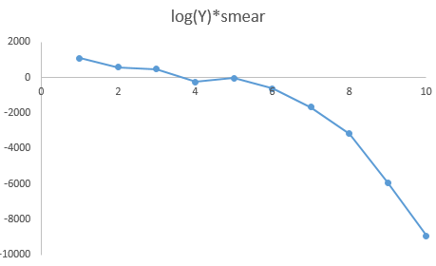
GOF tests: Model 3 (Log-OLS with smearing)
Pearson correlation: Significant correlation between residuals and predicted costs (P < 0.001)
Pregibon’s Link test: Significant association between xb^2 and outcomes (P=0.018)
Hosmer-Lemeshow test: Significant differences in the mean residuals (P < 0.001)

Slide 29
Comparison: Log-OLS w/ smear versus Log-OLS, OLS, & Raw Costs
Features | Raw | OLS | Log-OLS | Log-OLS w/ smearing
Mean | 10,625.10 | 10,625.10 | 3,919.37 | 12,462.22
SD | 23,462.30 | 3,367.80 | 1,971.28 | 6,267.96
Min | 0.00 | -387.98 | 625.86 | 1,990.02
Max | 552,898.00 | 21,010.64 | 12,892.53 | 40,993.70
Median | 3,517.00 | 10,704.85 | 3,599.10 | 11,443.86

Slide 30
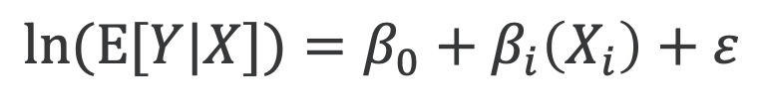
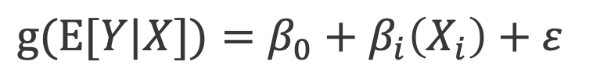
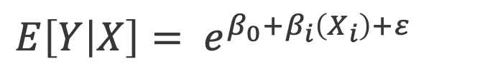
Model 4: Generalized Linear Model (GLM)
$$g(E[Y|X])=β_{0}+β_{i}\left(X_{i}\right)+ε$$
Rather than transform the raw Y, we are transforming the E(Y)
ln(u) = XB or u = exp(XB)
$$ln(E[Y|X])=β_{0}+β_{i}\left(X_{i}\right)+ε$$
$$E\left[Y | X\right]= e^{β_{0}+β_{i}\left(X_{i}\right)+ε}$$
Family | Link
Gaussian | identity
Binomial | logit, probit, cloglog
Poisson | identity, log, sqrt
Gamma | inverse, identity, log
Inverse Gaussian | inverse squared
GLM uses a link function, g(•)
Retransformation is not a problem
Apply a link function to the expectation of Y instead of the raw Y

Slide 31

Model 4: Generalized Linear Model (GLM)
Family selection is based on the relationship between Var[Y|X] and E[Y|X]
For γ = 0 use Gaussian (aka nonlinear least squares; constant variance)
For γ = 1 use Poisson (variance is proportional to the mean)
For γ = 2 use Gamma (variance is proportional to the square of the mean)
For γ = 3 use Wald or inverse Gaussian
Link selection is based on Pregibon’s link test
Modified Hosmer-Lemeshow test to assess structural fit

Slide 32
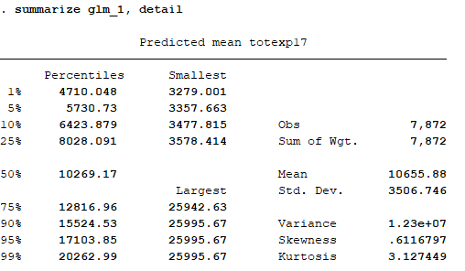
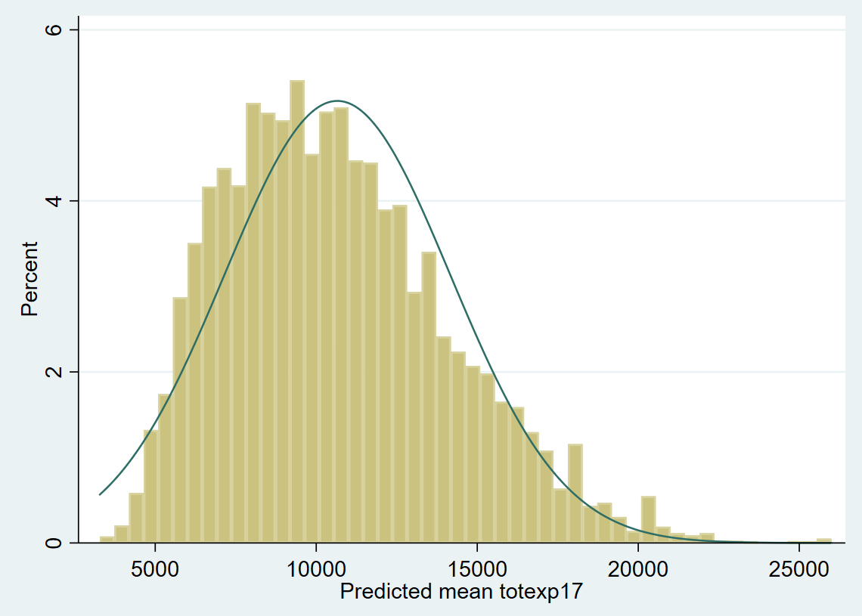
Model 4: Generalized Linear Model (GLM)
**** MODEL 4: GLM-log (gamma)
glm totexp17 age17x sex racev2x hispanx marry17x povcat17, family(gamma) link(log)
predict glm_1
summarize glm_1, detail

Slide 33
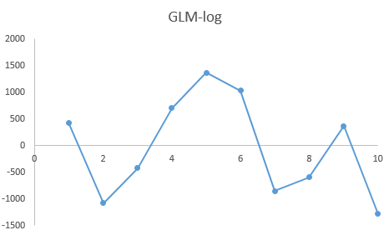
GOF tests: Model 4 (GLM-log)
Pearson correlation: No correlation between residuals and predicted costs (P = 0.276)
Pregibon’s Link test: No association between xb^2 and outcomes (P=0.406)
Hosmer-Lemeshow test: No differences in the mean residuals (P = 0.182)

Slide 34
Comparison: GLM-log, Log-OLS w/ smear, Log-OLS, OLS, & Raw Costs
Features | Raw | OLS | Log-OLS | Log-OLS w/ smearing | GLM-log
Mean | 10,625.10 | 10,625.10 | 3,919.37 | 12,462.22 | 10,655.88
SD | 23,462.30 | 3,367.80 | 1,971.28 | 6,267.96 | 3,506.75
Min | 0.00 | -387.98 | 625.86 | 1,990.02 | 3,279.00
Max | 552,898.00 | 21,010.64 | 12,892.53 | 40,993.70 | 25,995.67
Median | 3,517.00 | 10,704.85 | 3,599.10 | 11,443.86 | 10,269.17

Slide 35
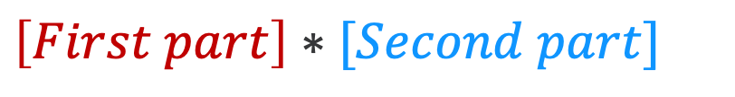
Model 5: Two-Part model
$$E\left[Y | X\right]=P\left(Y>0|X\right)∗E\left[Y | Y>0, X\right]+P\left(Y=0\right)∗E[Y|Y=0]$$
First part: logit or probit
Second part: GLM (gamma dist & log link)
$$\left[First part\right]∗[Second part]$$
Point mass of subjects with zero costs
Expected value of Y is conditioned on whether the subject has non-zero costs
P(Y>0) is determined by the logit/probit part
E[Y| Y>0] is provided by the second part
Large number of subjects with zero costs

Slide 36
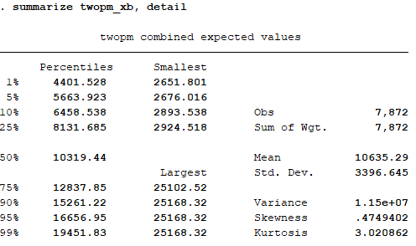
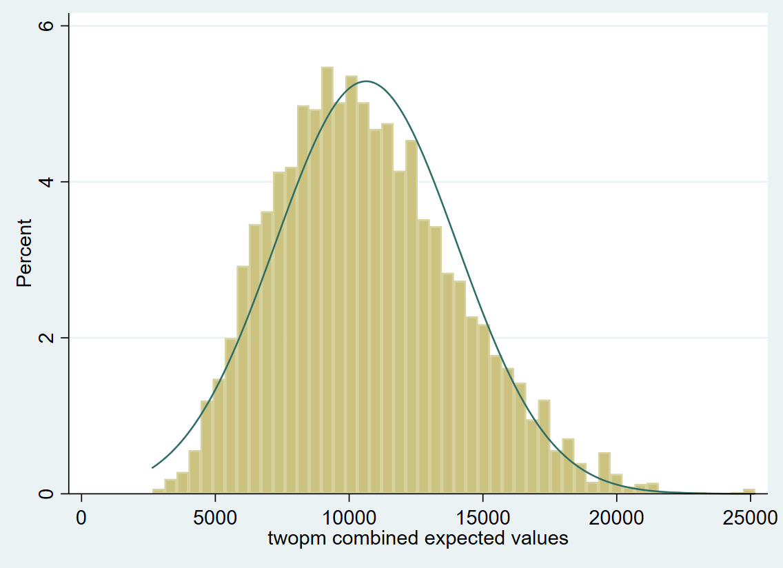
Model 5: Two-Part model
**** MODEL 5: two-part model
twopm totexp17 age17x sex racev2x hispanx marry17x povcat17, firstpart(logit) secondpart(glm, family(gamma) link(log))
predict twopm_xb
summarize twopm_xb, detail

Slide 37
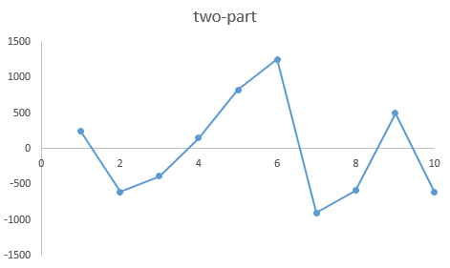
GOF tests: Model 5 (two-part model)
Pearson correlation: No correlation between residuals and predicted costs (P = 0.591)
Pregibon’s Link test: No association between xb^2 and outcomes (P = 0.296)
Hosmer-Lemeshow test: No differences in the mean residuals (P = 0.658)

Slide 38
Comparison: two-part, GLM-log, Log-OLS w/ smear, Log-OLS, OLS, & Raw Costs
Features | Raw | OLS | Log-OLS | Log-OLS w/ smearing | GLM-log | Two-part
Mean | 10,625.10 | 10,625.10 | 3,919.37 | 12,462.22 | 10,655.88 | 10,635.29
SD | 23,462.30 | 3,367.80 | 1,971.28 | 6,267.96 | 3,506.75 | 3,396.65
Min | 0.00 | -387.98 | 625.86 | 1,990.02 | 3,279.00 | 2,651.80
Max | 552,898.00 | 21,010.64 | 12,892.53 | 40,993.70 | 25,995.67 | 25,168.32
Median | 3,517.00 | 10,704.85 | 3,599.10 | 11,443.86 | 10,269.17 | 10,319.44

Slide 39
Poll # 3
What model would you use for cost as an outcome?
Ordinary Least Squares (Linear Regression) Model
Log-Transformed (Log-OLS) Model
Generalized Linear Model
Two-part model

Slide 40
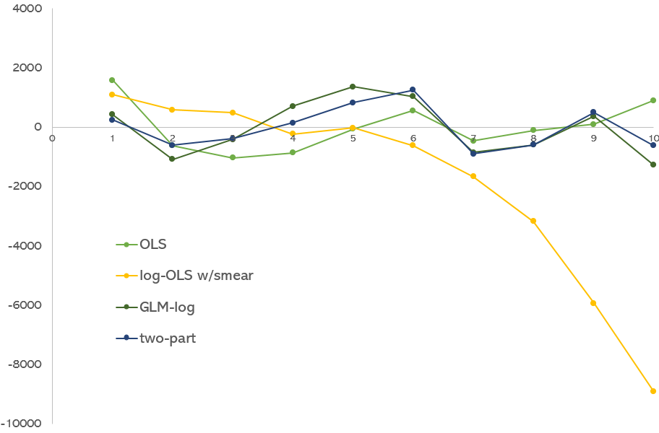
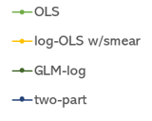
H-L test: residuals plotted on deciles
GLM-log and two-part models have the best residual patterns
 | OLS | Log-OLS | Log-OLS w/smear | GLM-log | two-part model
Pearson corr | 1.000 | <0.001 | <0.001 | 0.276 | 0.591
Pregibon link test | 0.003 | 0.028 | 0.018 | 0.406 | 0.296
H-L test | 0.549 | <0.001 | <0.001 | 0.182 | 0.658

Slide 41
References
GitHub repository of data and Stata codes (link)
Manning WG. The logged dependent variable, heteroscedasticity, and the retransformation problem. J Health Econ. 1998 Jun;17(3):283-95.
Manning WG, Mullahy J. Estimating log models: to transform or not to transform? J Health Econ. 2001 Jul;20(4):461-94
Basu A, Manning WG. Issues for the next generation of health care cost analyses. Med Care. 2009 Jul;47(7 Suppl 1):S109-14.
Belotti F, Deb P, Manning WG, Norton EC. Twopm: Two-Part Models. The Stata Journal. 2015;15(1):3-20.

Slide 42
References
Paul Barnett has done a two-part series on Cost As A Dependent Variable
Part 1 (link)
Part 2 (link)

Slide 43
Acknowledgements
Many of the codes were from lectures that I attended at the UW Advanced Methods Course Series.
These methods helped me to better understand the nuances associated with skewed data (e.g., costs and counts).
I recreated these codes for Stata as part of this presentation on modeling cost as a dependent variable.

Slide 44
Questions

Slide 45


Questions?
For more information visit the HERC website at www.herc.research.va.gov
Email us at HERC@va.gov
Call us at (650) 617-2630

